Slide 1
CISC 6352 – Advanced Computational Finance –Project 2
Hedge Fund Trade Analysis
Sheng Yun (syun13), Jingyan Xu (jxu246), Cathy Xueqing Zhang (xzhang347)

Slide 2

CONTEN TS
Data Cleaning
Explore Distributions
Feature Analysis
Linear Regressions
Recommendation

Slide 3
Data Cleaning
01

Slide 4
Dataset Overall
Overall
Data
Hedge fund trading dataset, include details about trade amount and related features, which effects profit
Total 6357
Hedge Fund Trade data
Features
Bad Value
19 features, majority are numeric, only exitTime and openTime are object
There are total 1645 nan,
550 nan in target 4 columns
Target
Focus on 'entrySlipPct','exitSlipPct’,
'allFeesDollars','profitPct'

Slide 5
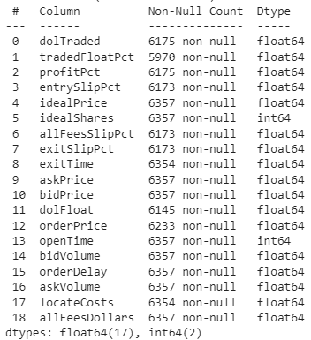

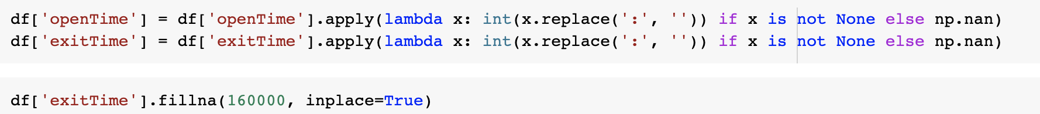
Data cleaning
Drop NAN
Only drop nan for columns we want to predict
After
Numeric columns
Before
Remove ‘:” from openTime and exitTime and change them to int
Notes:
Remain 162

Slide 6
Explore Distribution
02

Slide 7
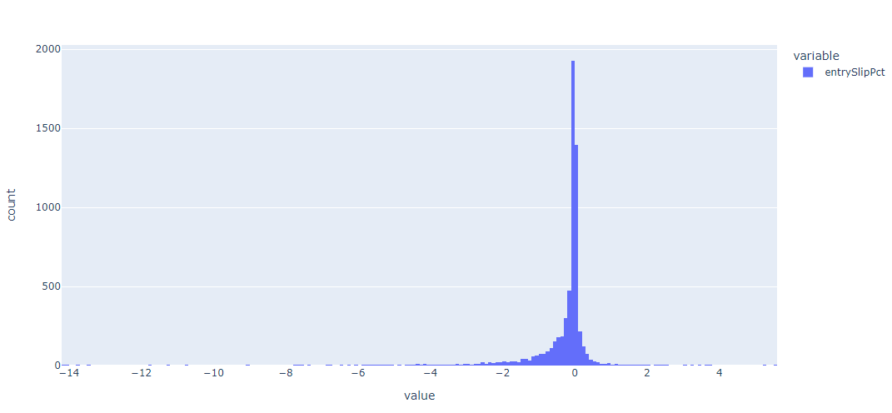
Histograms

Slide 8
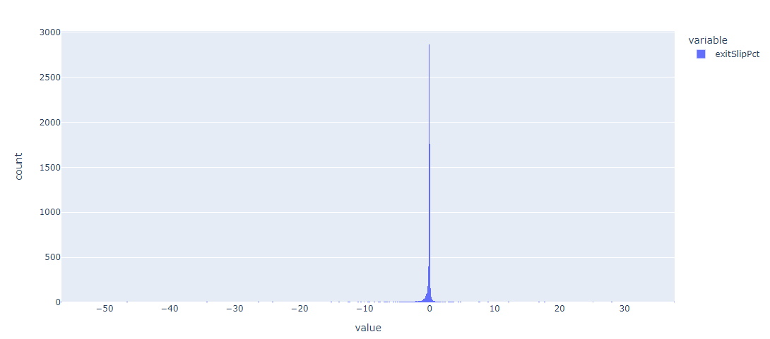
Histograms

Slide 9
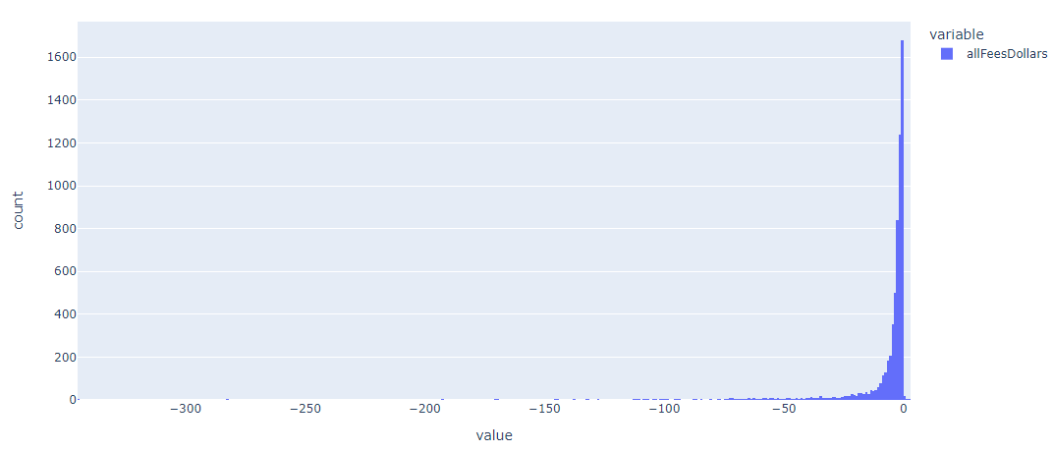
Histograms

Slide 10
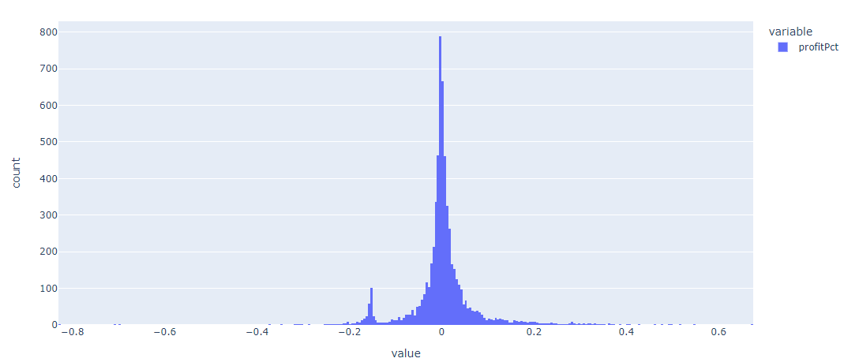
Histograms

Slide 11
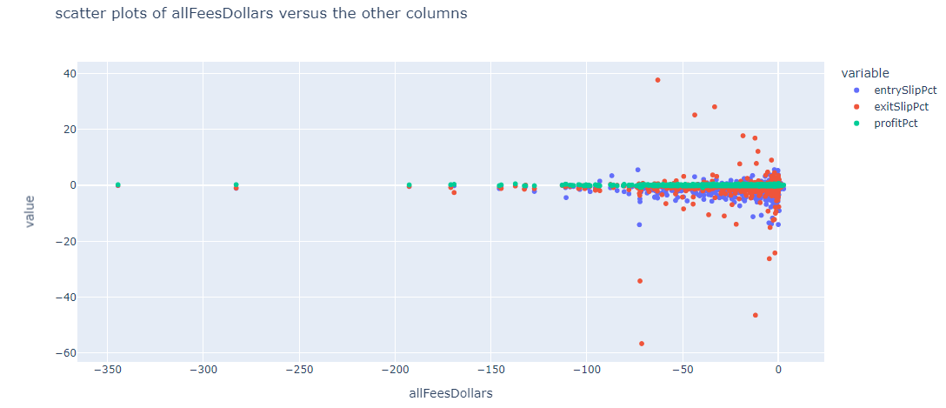
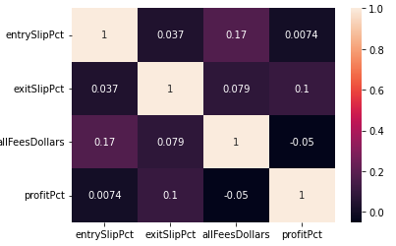
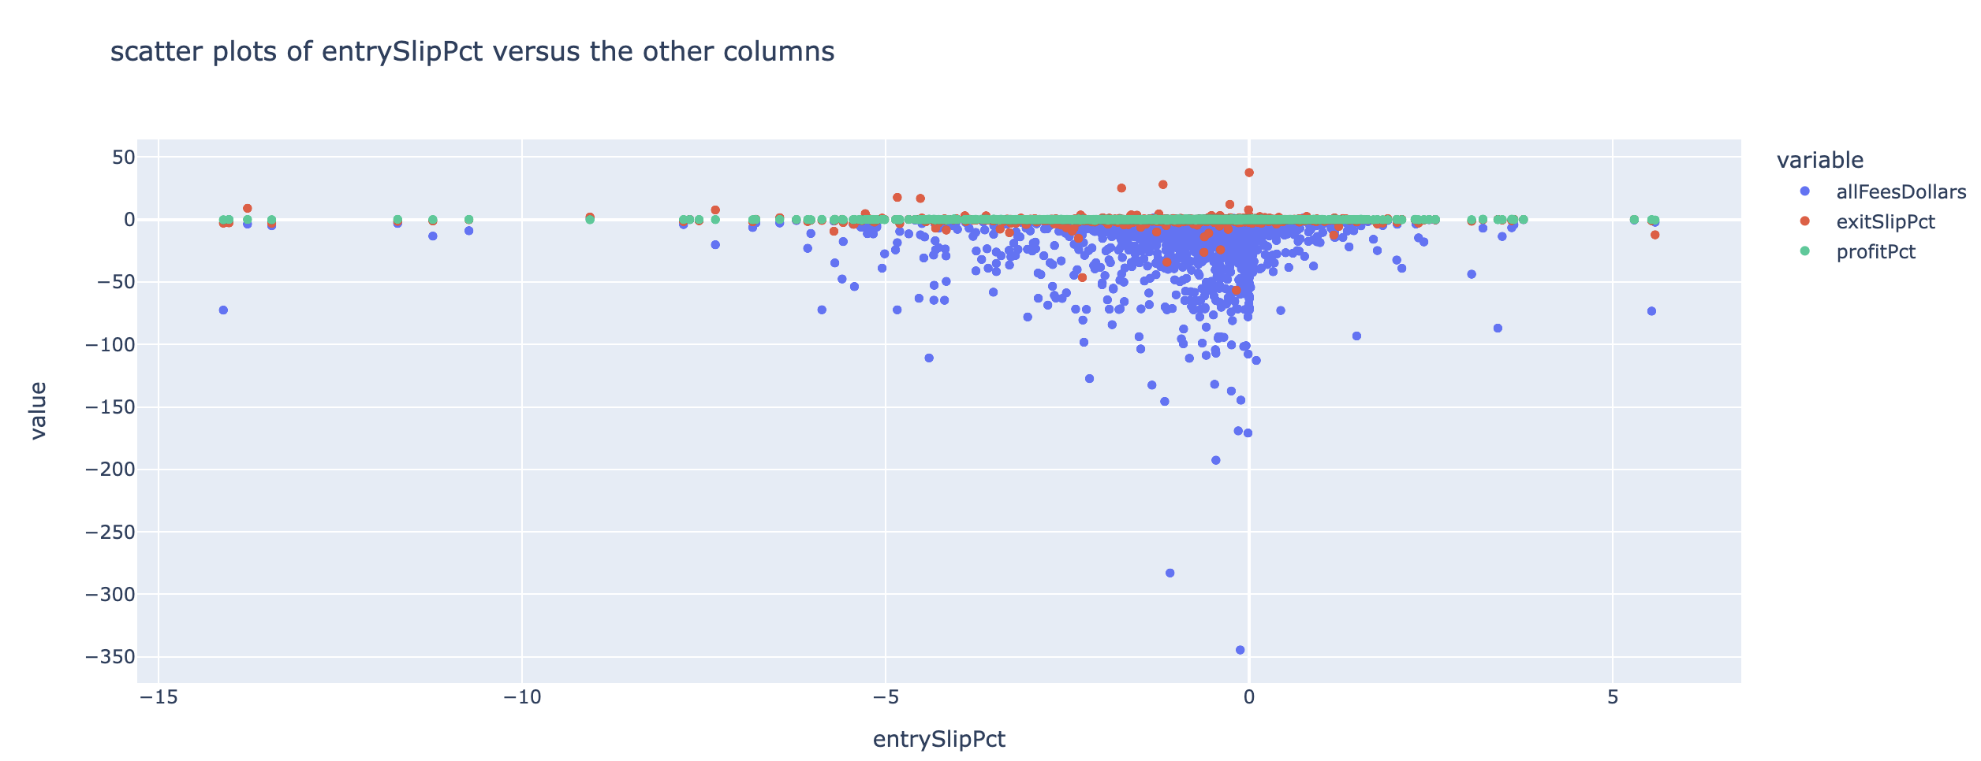
Correlation between target columns
Finding：
entrySlipPct affect allFeesDollars
We need to pay attention on entrySlipPct
Notes:
https://colab.research.google.com/drive/1J4Bn8tYSwDWNg2Djwbm8sFAhgCItk9eH?authuser=4#scrollTo=sQEvl5ihZMbz

Slide 12
Feature Engineering
03

Slide 13

Price columns: 'idealPrice', 'askPrice', 'bidPrice’,
'orderPrice'
Data Cleaning
Target
For ‘orderPrice’ columns: fill NAN with ‘ideaPrice’
Bad data

Slide 14
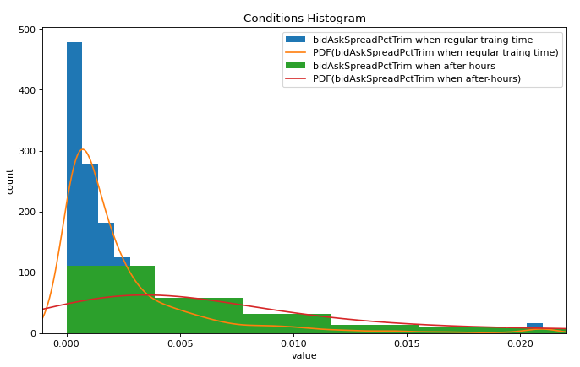
BidAskSpreadPct
bidAskSpreadPct = (askPrice-bigPrice)/idealPrice
Trim at 0.0
Plot the conditional distributions of bidAskSpreadPct during after-hours and regular trading hours
The bidAskSpread are more meaningful during Regular trading hours

Slide 15
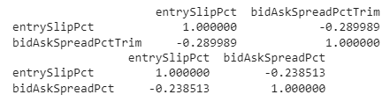
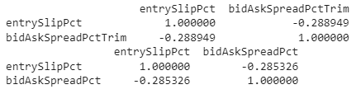
correlations to 'entrySlipPct'
Regular time trading
After-hours
Trimming help to increase the correlation between entrySlipPct and bidAskSpread
bidPrice or askPrice or idealPrice alone not works

Slide 16
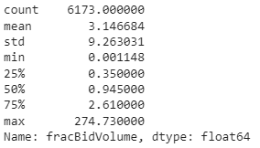
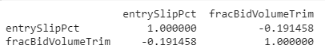
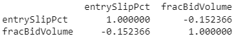
Calculate fracBidVolume
fracBidVolume = idealShares / bidVolume
There are outliers
Trimming fracBidVolume (0.01/0.99)
Trimming help to increase the correlation between entrySlipPct and bidAskSpread
Bid fraction characterizes the bidding strategy

Slide 17
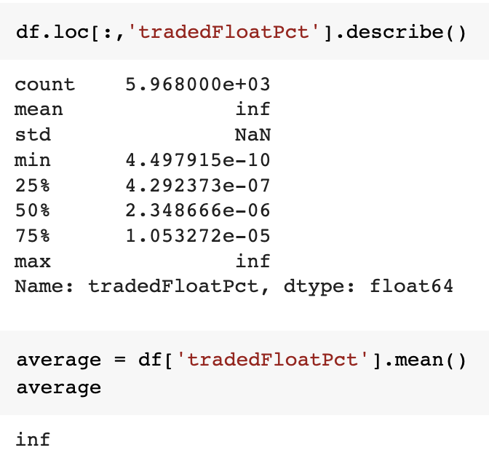
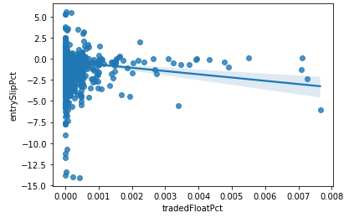
Fix tradedFloatPct
Bad Value
Inf value in tradedFloatPct
Missing values
tradedFloatPct has 205
entrySlipPct is 0
Fill missing values with the mean
Plot the regression graph
more you trade as a percentage of float (i.e. tradedFloatPct), the more slippage (i.e. entrySlipPct)

Slide 18
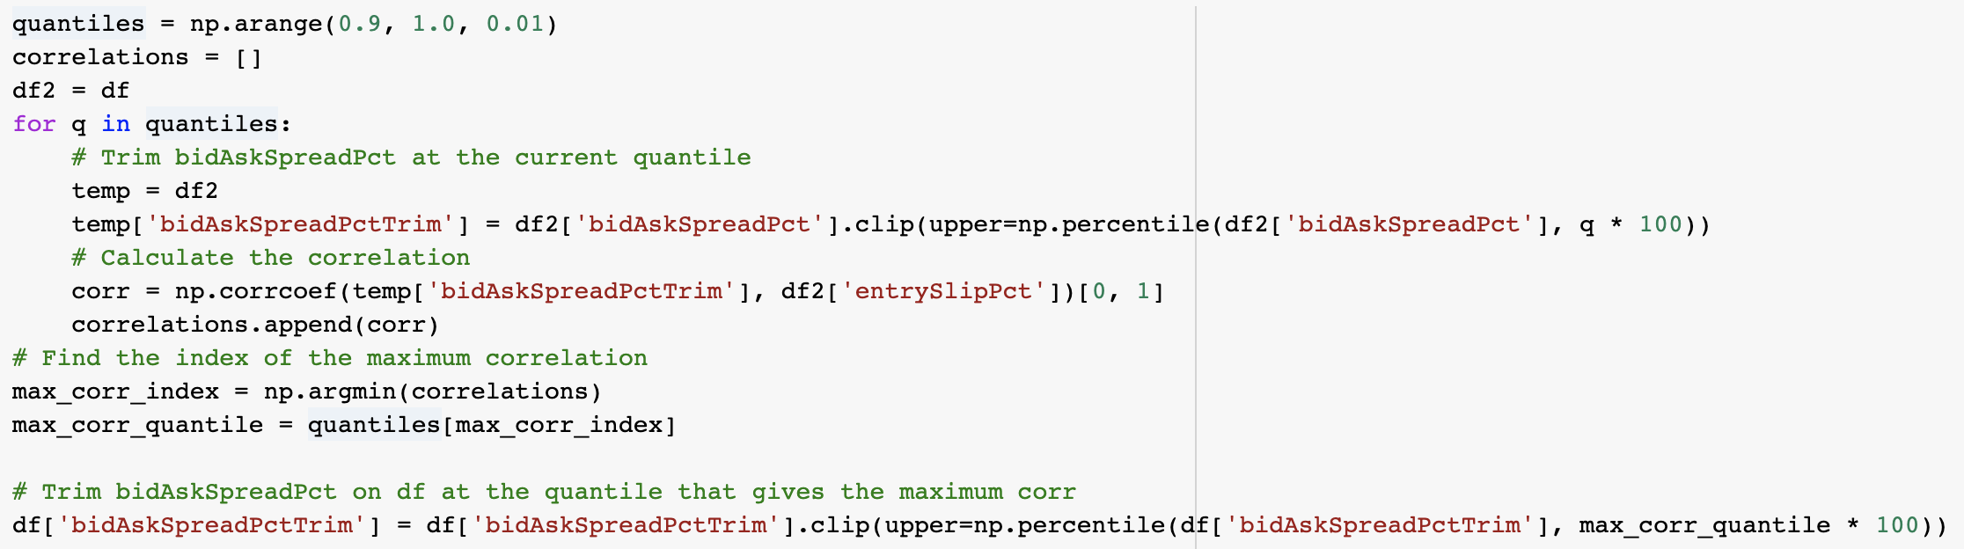
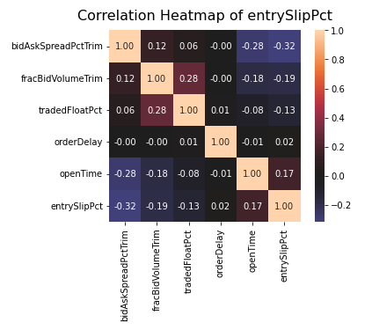
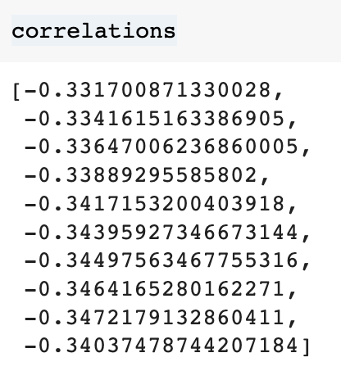
Linear Regressions

Slide 19
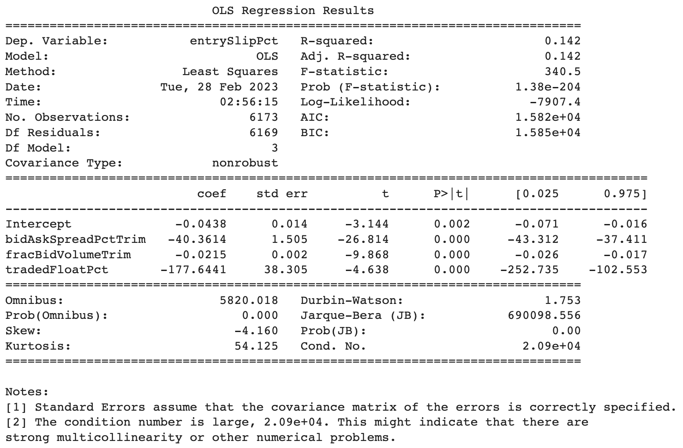
formula = 'entrySlipPct ~ bidAskSpreadPctTrim + fracBidVolumeTrim + tradedFloatPct'

Slide 20
Recommendation
04

Slide 21
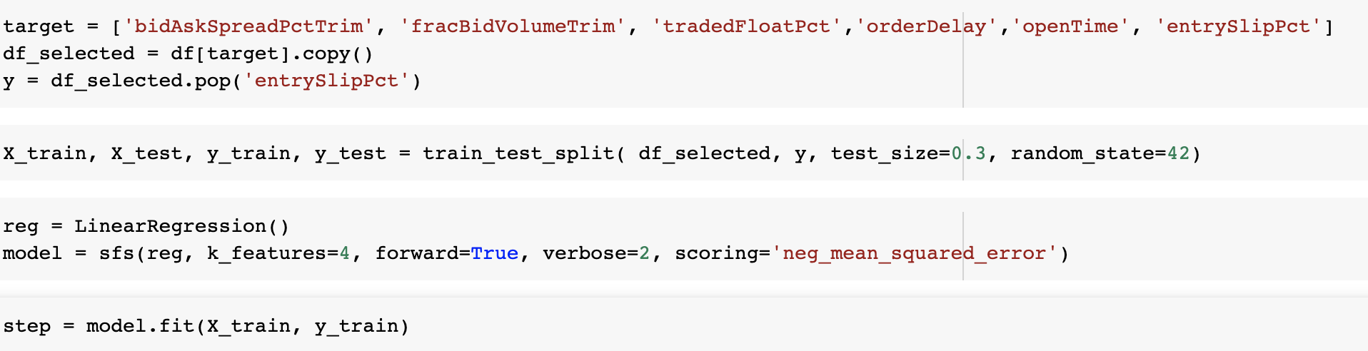
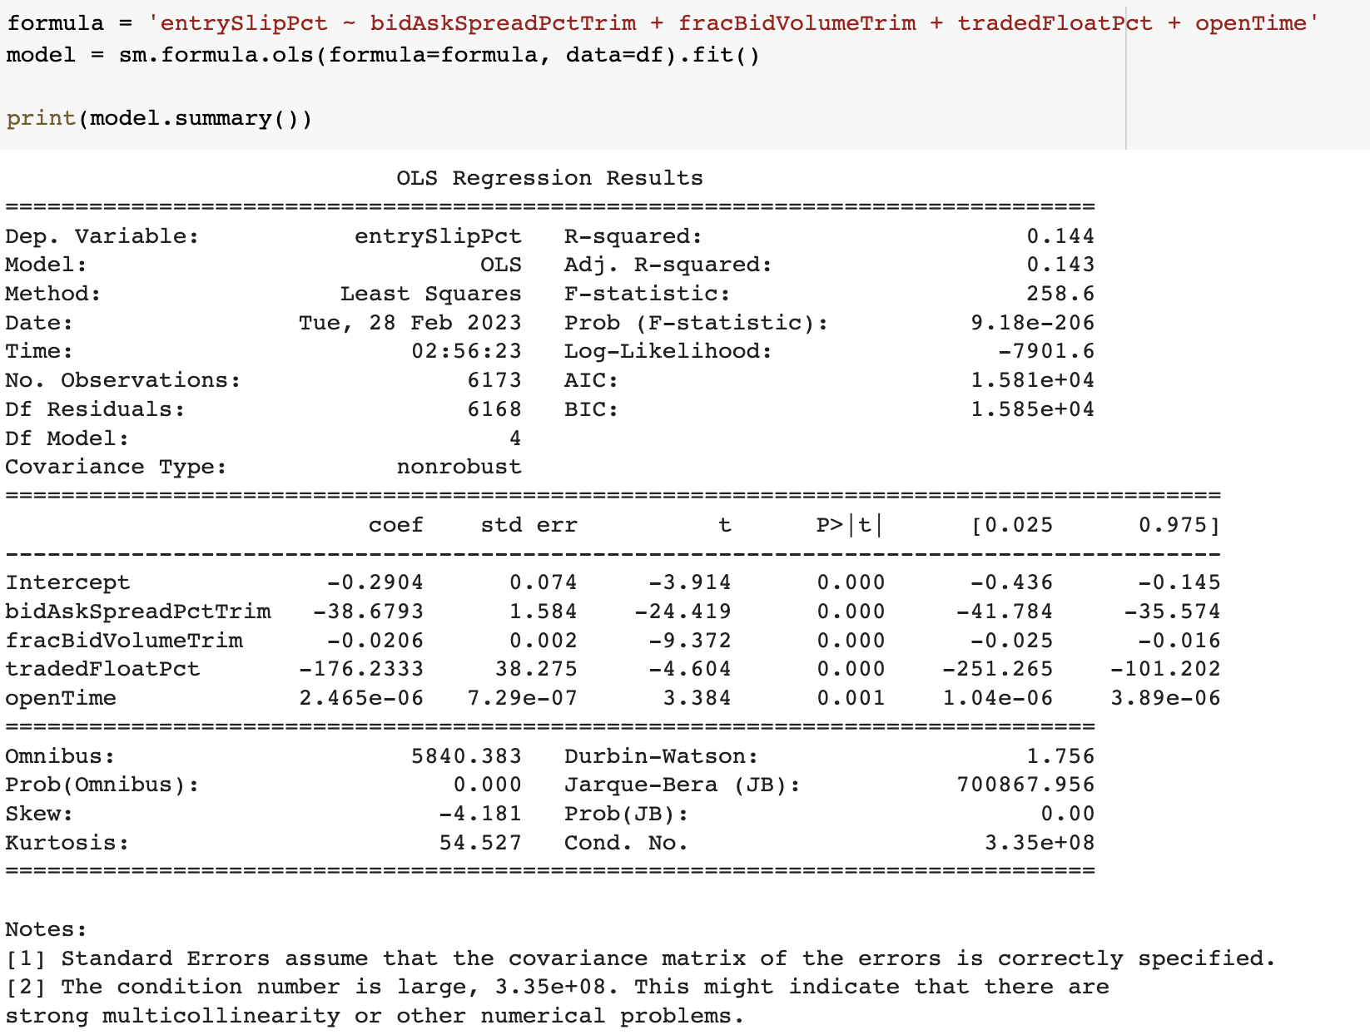
How to earn more money

Slide 22

Recommendations to increase proftPct more than 14.419%
Avoiding high entrySlipPct
entrySlipPct
narrower bid-ask spread
bid-ask spread
Try not trade at Float
tradedFloatPct
Trade during regular time and make use of limit orders instead
Type and time

Slide 23
Thank you
Sheng Yun (syun13), Jingyan Xu (jxu246), Cathy Xueqing Zhang (xzhang347)
1/30/2023

